Slide 1

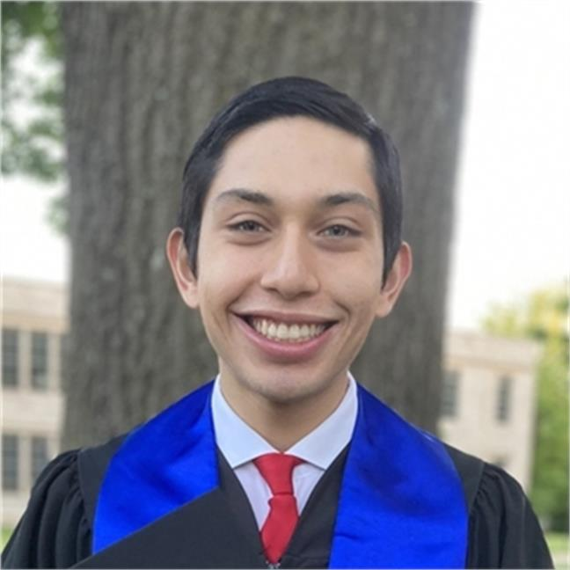
Adaptive Cards
Community call
Universal Actions + Messaging Extensions 🌐
Accessibility Updates 🔍
Q&A ❔
Karan Thapar Microsoft
J.P. Roca Microsoft
April 14, 2022

Slide 2
Universal Action Model
Notes:
I wanted to give you all a recap on Viva Connections, and how the Adaptive Card framework plays a big role in the extensibility world of Viva Connections, for both 1P and 3P components and how the devs can use that to extend VC experience in the dashboard.

Slide 3
Accessibility Updates
Notes:
I wanted to give you all a recap on Viva Connections, and how the Adaptive Card framework plays a big role in the extensibility world of Viva Connections, for both 1P and 3P components and how the devs can use that to extend VC experience in the dashboard.

Slide 4
Q&A

Slide 5
Thank you
Recording will be available on
Microsoft 365 Community (PnP) YouTube channel
https://aka.ms/M365PnP/videos
(subscribe today)
Follow us on Twitter
@Microsoft365Dev | @M365PnP
Next Adaptive Cards community call: May 12th at 09:00am PT
All available community calls from https://aka.ms/m365pnp

Slide 6
Resources
Let us know the features you need https://aka.ms/ACRoadmap
Get started with Templating https://aka.ms/ACTemplating
Browse the Adaptive Cards Code https://aka.ms/ACRepo
Find tools, sample cards and more https://www.madewithcards.io

Slide 7
Microsoft 365 developer community calls
Microsoft 365 platform (weekly) https://aka.ms/m365-dev-call
Adaptive Cards (monthly) https://aka.ms/adaptivecardscommunitycall
Microsoft identity platform (monthly) https://aka.ms/IDDevCommunityCalendar
Office Add-ins (monthly) https://aka.ms/officeaddinscommunitycall
PowerApps (monthly) https://aka.ms/PowerAppsMonthlyCall
Microsoft 365 Dev Community (bi-weekly) https://aka.ms/m365-dev-sig
Viva Connections and SPFx (bi-weekly) https://aka.ms/spdev-spfx-call
https://aka.ms/m365pnp
Notes:
m365-dev-sig

